Slide 1

Team II: Functional Annotation Results
Group members: Michael Pham, Akshita Singh, Kaize Ali, Kate Xie, Lindsey Tucker, Isabelle Du Plessis

Slide 2
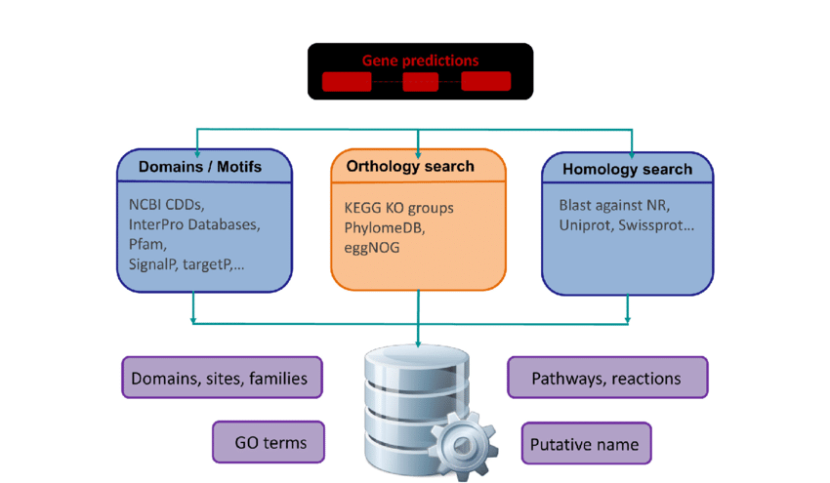
What is functional annotation?
Identifying functional elements along the sequence of a genome based on the assembled and predicted gene sequences, thus giving meaning to it.
Pre-build pipelines: combining the gene prediction and functional annotation.
We want information on the functional aspects of the gene and how they are interconnected

Slide 3
Homology vs Ab Initio methods
Homology
Takes information from experimentally derived knowledge. We compare samples to pre-existing databases which contain similar information of the genome
Pros: accurate when shown high similarity to the sequence or shared ancestry, which often leads to the shared function
Cons: Not precise enough in cases where there are low similarity with the template. A lot slower to search against, comparing to millions of genomes.
Databases used: COG, EGGNOG, CARD, OMPdb, VFDB, PHROGs
Tools used: MMSeqs2, Diamond
Ab-initio
Uses a self-learning algorithm/method to annotate models.
Relies on good input for training models but in practice most do not re-train a model.
No external databases/references are required however it relies on heavily conserved patterns found in functional motifs and domains
Tools used: SignalP6.0, TMHMM2.0, CrisprCasTyper

Slide 4
Input:
.fna
.faa
.gff
clustering
TMHMM2.0
MMSeqs2
eggNOG
CrisprCasTyper
DIAMOND
CARD
OMPdb
blast tabular
COG
VFDB
PLSDB
PHROGS
.tsv
.tab
.gff
.fna
SignalP6.0
.gff
.gff
blast tabular
.gff
.fna
.gff
Ab Initio
Homology
GFF Validator
Final merged annotated output files
.gff
.fna
.faa

Slide 5
BLASTx
Blastx is a gene-finding/predicting tool used to identify protein-coding genes in a novel nucleotide sequence and can be used to identify proteins encoded by transcripts.
This is done by comparing a DNA query sequence translated into six reading frames against a protein database which allows for gaps.

Slide 6
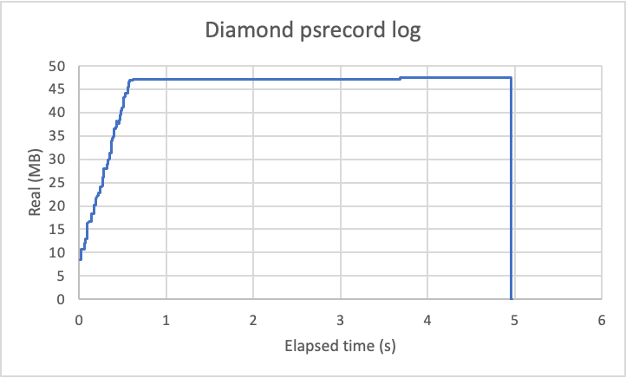
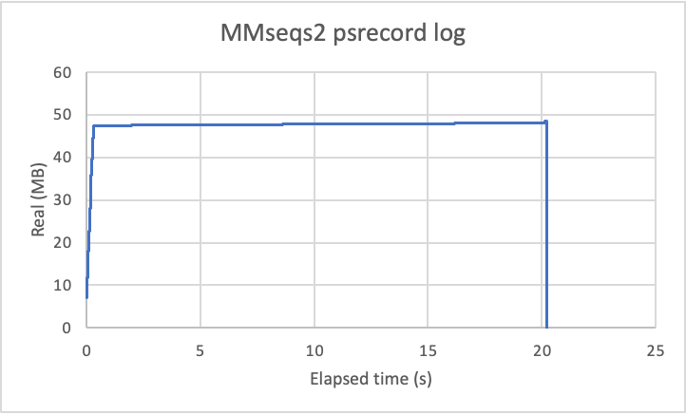
Clustering: Diamond vs MMseqs2
Clustering sequences to reduce size
Used psrecord to log time and CPU/RAM usage
Max usage similar, runtimes differ
Ran 5 smallest test files for each
Tool | Functions annotated | Runtime | CPU/RAM usage
diamond | clustering | 4.12 s | ~47 MB max
MMseq2 | clustering | 20.22 s | ~47 MB max

Slide 7
Clustering: Diamond
Command line:
diamond cluster -d $file -o ./$outfile.cluster.tsv --approx-id 50 -M 64G –header
--approx-id 50
Clustered sequences to 50% identity
Lower identity increased running time
Output: .tsv file with clustered IDs.
Used seqkit afterwards to generate .faa files based off of the clustered sequence IDs
Percent file size reduction
"--approx-id" | CGT2044.faa (361K) | CGT2364.faa (1.9M)
50 | 2.70% | 4.60%
40 | 3% | 9%
30 | 7% | 16%

Slide 8
Diamond
Also had optimal outputs of blastp and blastx for conversion to .gff
Custom blast-like output with necessary info for .gff and .fna
Parsed output with a python script to convert outputs into .gff format
Used gff version 3 formatting
Used diamond blastx with different databases

Slide 9
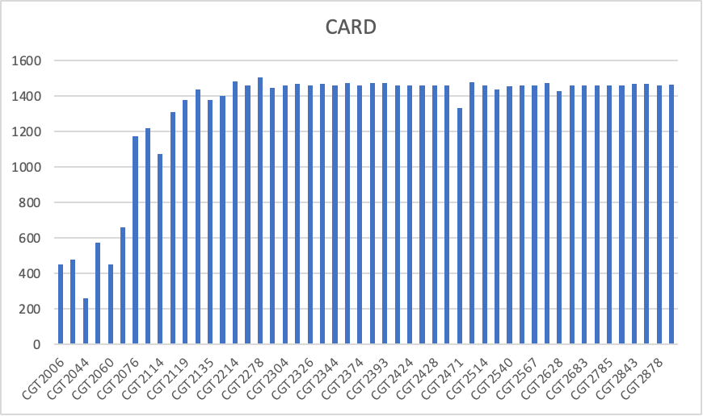
CARD Database
Antibiotic resistance gene databases:​
​
Comprehensive Antibiotic Resistance Database (CARD) is a web-based database containing information and data on antibiotic resistance genes and associated antibiotics.​
Statistics: 26,000 resistance gene sequences, > 2,500 antibiotics, and > 800 resistance mutations. ​
Antibiotic Resistance genes were annotated by performing a blastx search using the card database as a reference in the diamond format.
Other tools like AMRFinder and the rgi software were tested out but since their output files were not not in a similar format as the other tools, we went ahead with using the card database in the diamond format to generate similar files.
diamond blastx --db card.dmnd -q $f -o ${f%.fna}.tsv --outfmt 6 qseqid sseqid pident length mismatch gapopen qstart qend sstart send evalue bitscore qframe qseq
real 0m27.111s
user 1m26.289s
sys 0m4.196s

Slide 10
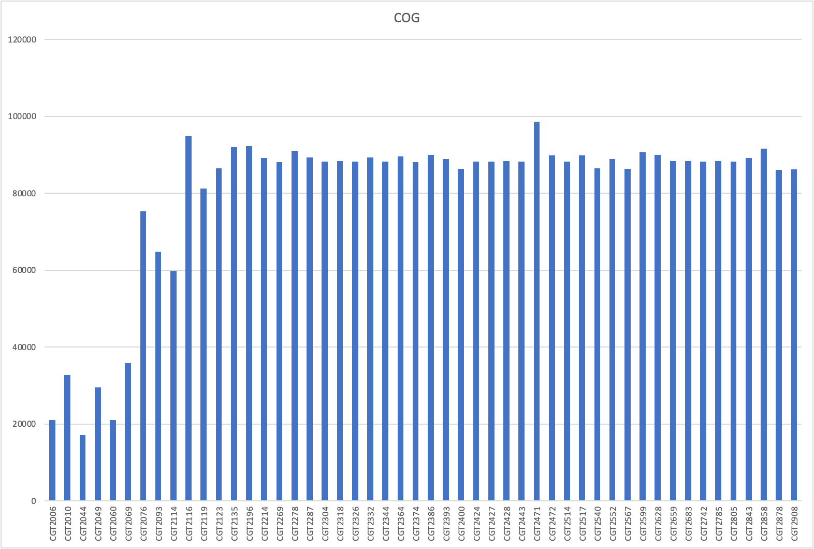
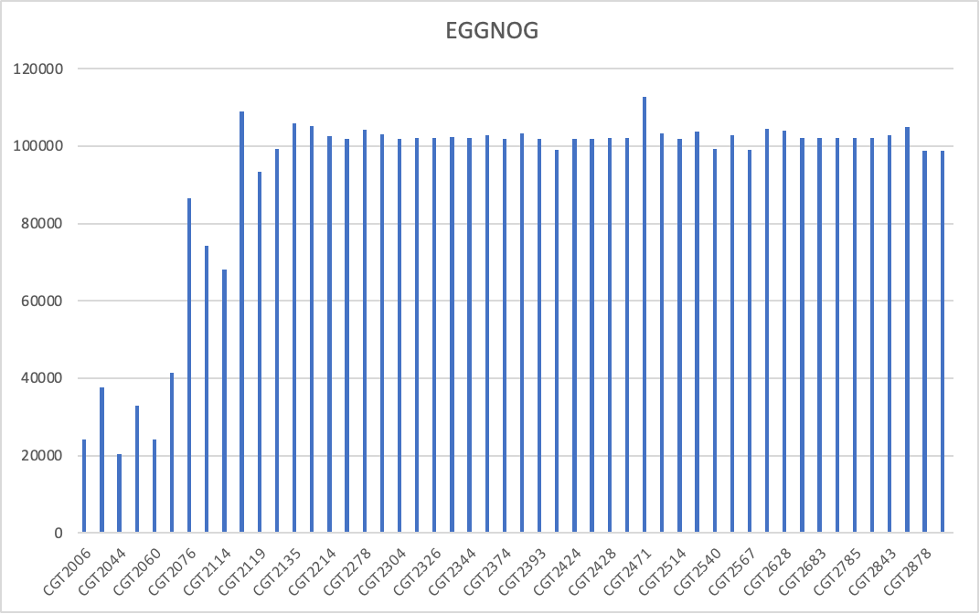
Cog and Eggnog with Diamond results
A blastx search was done for both (using a bacterial protein database for EGGNOG and the COG2020 database for COG) in the diamond format.
Both COG and EGGNOG annotate orthologous groups but differ in their approaches.
The protein grouping done by COG is based on evolutionary history.
The initial concept behind COGs served as the foundation for the eggNOG database, which is maintained by the EMBL. However, eggNOG expands on this by incorporating groups based on functional similarity and non-supervised orthologous groups built from numerous species. Consequently, compared to COGs alone, eggNOG offers a more thorough description of gene function.
As the grouping methods and data included vary for both databases, annotating genes with both databases ensure that OG groups unique to each data are not missed.
./diamond blastx --db /home/team2/databases/COG2020/cog-20-db.dmnd -q $f -o ${f%.fna}.tsv --outfmt 6 qseqid sseqid pident length mismatch gapopen qstart qend sstart send evalue bitscore qframe qseq
diamond blastx --db /home/team2/databases/eggnog/bacteria.dmnd -q $f -o ${f%.fna}.tsv --outfmt 6 qseqid sseqid pident length mismatch gapopen qstart qend sstart send evalue bitscore qframe qseq

Slide 11
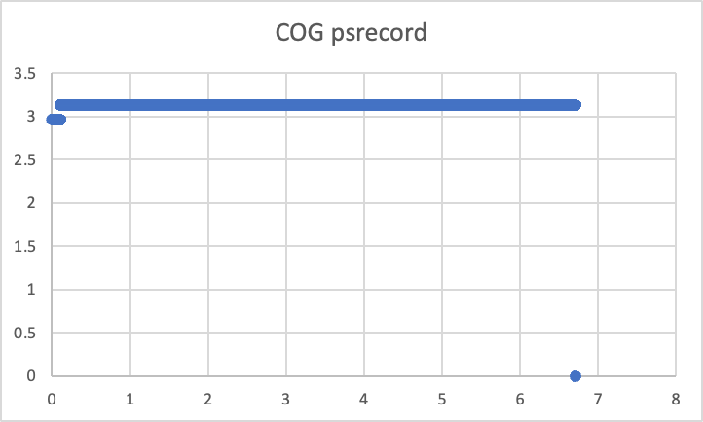
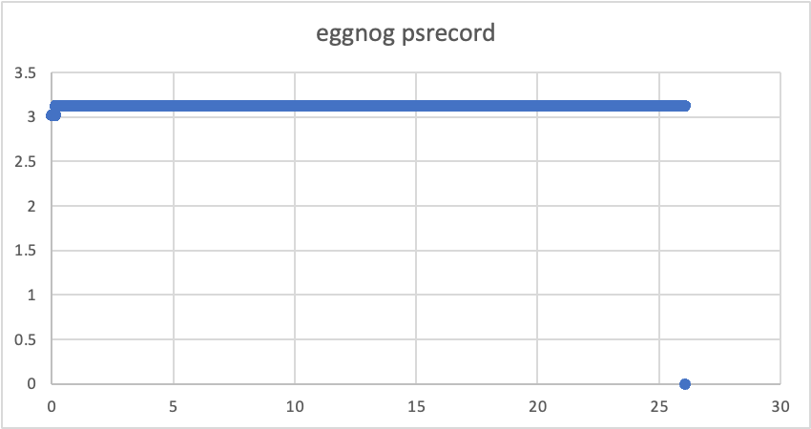
Cog and Eggnog with Diamond results
Time taken for all 50 files and CPU utilization for the test files (5 files):
real 17m28.590s
user 88m40.890s sys 3m11.773s
real 44m33.447s
user 323m11.090s
sys 10m54.411s

Slide 12
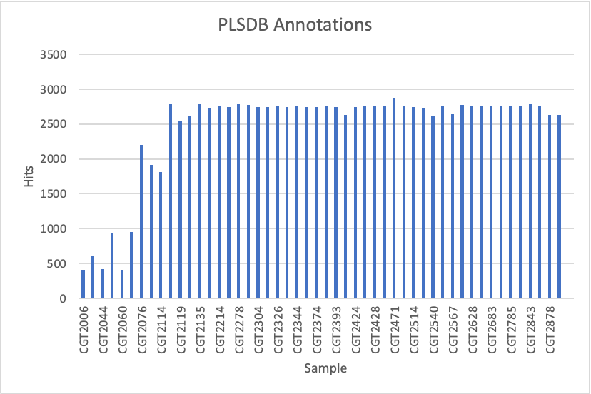
Plasmid Database PLSDB
13,789 plasmid records collected from the NCBI nucleotide database
Includes PlasmidFinder database records
MMseqs2 command:
mmseqs easy-search sample.fna PLSDB sample.m8 tmp --search-type 3 --format-output query,target,pident,alnlen,mismatch,gapopen,qstart,qend,tstart,tend,evalue,bits,qframe,qseq -s 7.5 -v 0

Slide 13
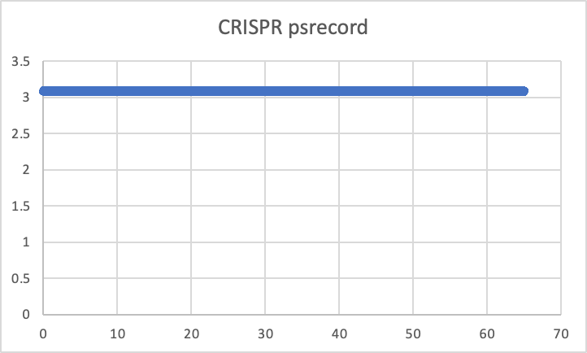
Crispr Annotation
CRISPRCasTyper was used to detect CRISPR-Cas genes.
It uses the ab-initio method for gene annotation
Cas genes are detected via Hidden Markov Models (HMM) then grouped into operons and the subtype is predicted using a scoring scheme.
CRISPR arrays are identified using ML to link them to the Cas operon resulting in locating the CRISPR-Cas genes.

Slide 14
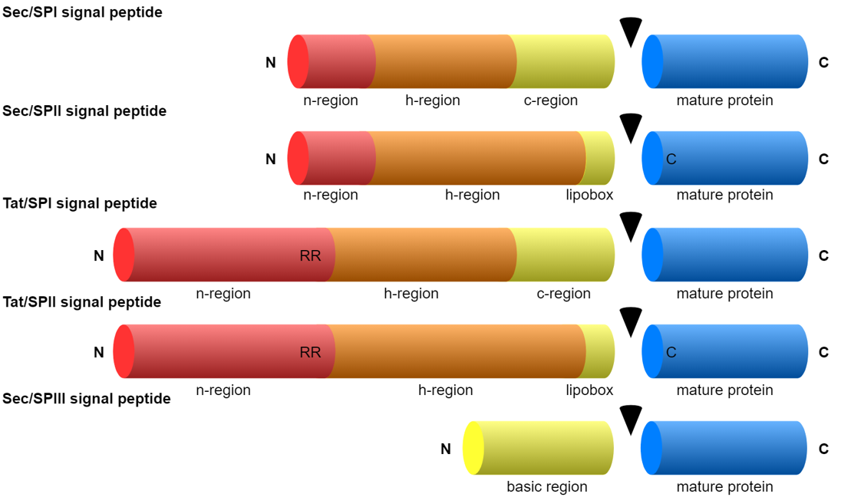
SignalP 6.0
Signalp predicts the presence and location of signal peptide cleavage sits in amino acids sequences in organisms
Input file: .faa
Output file: Prediction.txt, output_region.gff3, output.gff3, processed_entries.fasta

Slide 15
SignalP 6.0 Specifications
Extremely important to add multiprocessing to script to run in parallel to condense time
Flags:
--organism: other
--fastafile: *.faa files
--format: txt
--mode: fast
Command line (without running multiple processes in parallel):
signalp6 --fastafile "$file" --organism other --output_dir
~/downloads/data_from_group22/"$filename" --format txt --mode fast
The output.gff3 file has a space in header issue, this for loop cleans up the format for all files:
for file in *.gff3; do
sed 's/## gff-version/##gff-version/' "$file" > "${file%.gff3}.gff"
done
Tool | Runtime | CPU/RAM usage
SignalP 6.0 | 1hr 12mins | 236%

Slide 16
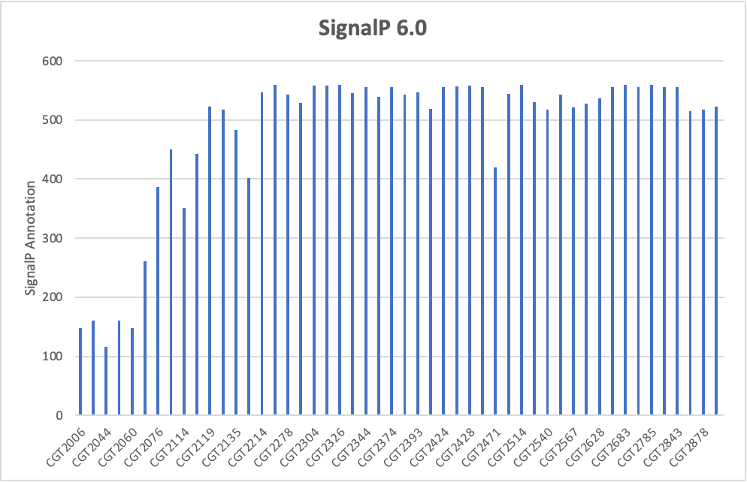
SignalP 6.0 hits

Slide 17
Outer Membrane Protein database
aka OMPdb
Used diamond blastx to find reciprocal hits with .fna files
Making a diamond database:
./diamond makedb --in OMPdb.fasta -d OMPdb
Command line:
diamond blastx --iterate --top 10 -d OMPdb.dmnd -q $file –o $outfile.blast -f 6 qseqid sseqid pident length mismatch gapopen qstart qend sstart send evalue bitscore qframe qseq
--iterate: runs multiple rounds of increasing sensitivity
--top 10: outputs only the top 10% best alignment scores
-f 6: blast tabular format with 12 default fields with added qframe and qseq

Slide 18
Outer Membrane Protein database

Slide 19
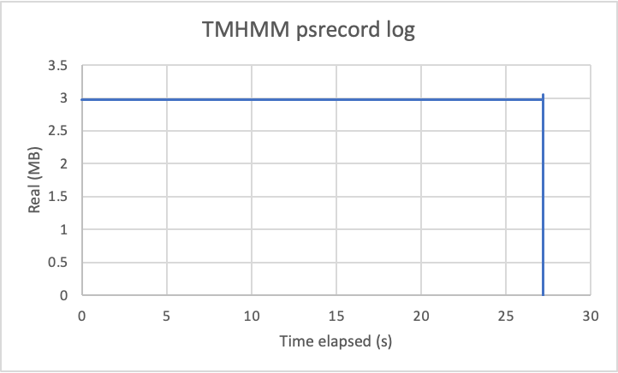
TMHMM-2.0
DeepTMHMM has a file limit and requires Docker installation to exceed the limit
Tested TMHMM-2.0 with psrecord on 5 test files
Command line:
tmhmm $file > $outfile.tmhmm.out
gives output .tsv file with five header lines followed by a single tab separated line of:
seqID, TMHMM2.0, prediction (inside/outside), start, and stop position.
To convert into .gff and .faa/.fna, created a .py script to parse files.
tmhmmout_convert.py

Slide 20
TMHMM

Slide 21
Virulence Factor
Database: VFDB core protein (1.1MB)
Tools comparison:
Both tools use the most sensitive mode to compare their performance
Use MMseqs2 BLASTX for downstream annotation
Example usage:
mmseqs easy-search ${FILE} /home/team2/databases/VFDB/VFDB_setA_pro.fas.gz ${SAMPLE}.m8 tmp --format-output query,target,pident,alnlen,mismatch,gapopen,qstart,qend,tstart,tend,evalue,bits,qframe,qseq -s 7.5 -v 0
-s 7.5 most sensitive
Query: fna, Database faa (automatically create ntDB and aaDB)
 | MMseqs2 | DIAMOND
speed | ~5s | ~1.8s
Number of hits | ~2476 (CGT2060) | ~2071 (CGT2060)

Slide 22
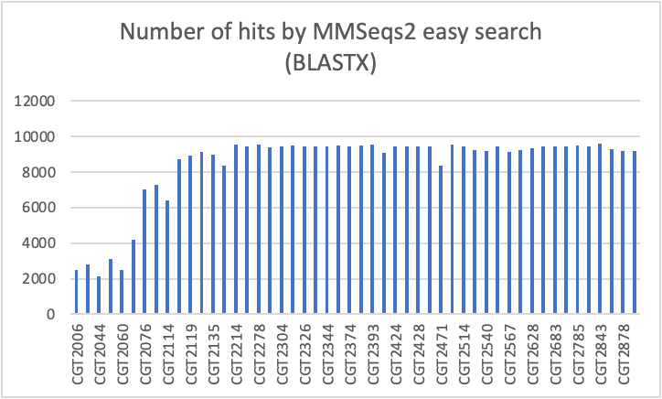
Virulence Factor

Slide 23
Prophages
Database: PHROGs protein (53MB)
Tools comparison:
Both tools use the most sensitive mode to compare their performance
Use MMseqs2 BLASTX for downstream annotation
Since PHROGs is large, is better to create a DB (prevent recursively create large DB 50 times)
Cat to combine all the PHROGs ortholog group faa files
Generate database through mmseqs createdb phrog.faa phrogDB
mmseqs easy-search ${FILE} phrogDB ${SAMPLE}.m8 tmp --format-output query,target,pident,alnlen,mismatch,gapopen,qstart,qend,tstart,tend,evalue,bits,qframe,qseq -s 7.5 -v 0
 | MMseqs2 | DIAMOND
speed | ~16s | ~60s
Number of hits | ~23K (CGT2060) | ~6K(CGT2060)

Slide 24
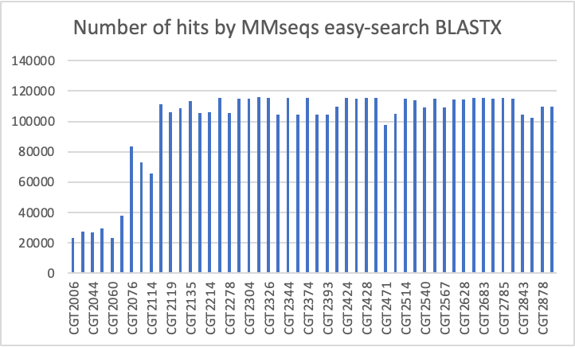
Prophage

Slide 25
Merging files
GFF Validator
Merging_gff.py
if seqname, start, end of gff1.line == seqname, start, end of gff2.line
gff1.line.attribute.append(gff2.line.attribute)
Else
gff1.append(gff2.line )
Example usage:
./merge_gff.py -g1 <1.gff> -g2 <2.gff> -o <merged.gff>

Slide 26
Summary
Our reads have the following functional annotations:
Orthologous groups
Antibiotic resistance
Prophage
Virulence
Plasmids
Outer, inner, and transmembrane protein
Signal peptide
crispr

Slide 27
References
Hernández-Salmerón, J.E., Moreno-Hagelsieb, G. Progress in quickly finding orthologs as reciprocal best hits: comparing blast, last, diamond and MMseqs2. BMC Genomics 21, 741 (2020). https://doi.org/10.1186/s12864-020-07132-6
Buchfink, B., Ashkenazy, H., Reuter, K., Kennedy, J. A., & Drost, H.-G. (2023). Sensitive clustering of protein sequences at tree-of-life scale using DIAMOND DeepClust (p. 2023.01.24.525373). bioRxiv. https://doi.org/10.1101/2023.01.24.525373
Hallgren, J., Tsirigos, K. D., Pedersen, M. D., Almagro Armenteros, J. J., Marcatili, P., Nielsen, H., Krogh, A., & Winther, O. (2022). DeepTMHMM predicts alpha and beta transmembrane proteins using deep neural networks. BioRxiv, 2022.04.08.487609. https://doi.org/10.1101/2022.04.08.487609
MMseqs2 enables sensitive protein sequence searching for the analysis of massive data sets | Nature Biotechnology. (n.d.). Retrieved March 4, 2023, from https://www.nature.com/articles/nbt.3988
Natarajan, J., & Ganapathy, J. (2007). Functional gene clustering via gene annotation sentences, MeSH and GO keywords from biomedical literature. Bioinformation, 2(5), 185–193.
Steffen Möller, Michael D. R. Croning, Rolf Apweiler, Evaluation of methods for the prediction of membrane spanning regions , Bioinformatics, Volume 17, Issue 7, July 2001, Pages 646–653, https://doi.org/10.1093/bioinformatics/17.7.646
Krogh, Anders, Björn Larsson, Gunnar von Heijne, and Erik L.L Sonnhammer. “Predicting Transmembrane Protein Topology with a Hidden Markov Model: Application to Complete Genomes11Edited by F. Cohen.” Journal of Molecular Biology 305, no. 3 (January 2001): 567–80. https://doi.org/10.1006/jmbi.2000.4315.
https://www.ncbi.nlm.nih.gov/pmc/articles/PMC3013687/
https://academic.oup.com/nar/article/38/suppl_1/D396/3112269#64941422
https://academic.oup.com/nar/article/48/D1/D517/5608993
Sharma, Aditya Kumar et al. “Bacterial Virulence Factors: Secreted for Survival.” Indian journal of microbiology vol. 57,1 (2017): 1-10. doi:10.1007/s12088-016-0625-1
Chen, Lihong et al. “VFDB: a reference database for bacterial virulence factors.” Nucleic acids research vol. 33,Database issue (2005): D325-8. doi:10.1093/nar/gki008
Srividhya, K V et al. “Identification of prophages in bacterial genomes by dinucleotide relative abundance difference.” PloS one vol. 2,11 e1193. 21 Nov. 2007, doi:10.1371/journal.pone.0001193
Hernández-Salmerón, Julie E, and Gabriel Moreno-Hagelsieb. “Progress in quickly finding orthologs as reciprocal best hits: comparing blast, last, diamond and MMseqs2.” BMC genomics vol. 21,1 741. 24 Oct. 2020, doi:10.1186/s12864-020-07132-6
Eddy, S R. “Profile hidden Markov models.” Bioinformatics (Oxford, England) vol. 14,9 (1998): 755-63. doi:10.1093/bioinformatics/14.9.755
CRISPR https://bioinfo.cd-genomics.com/crispr-bioinformatics-analysis.html#:~:text=The%20CRISPR%2DCas9%20gene%20targeting,technique%20with%20many%20possible%20applications.
Noncoding RNA analysis (ncRNAs) https://www.cd-genomics.com/bioinformatics-tools-for-non-coding-rna-analysis.html
Roosaare M, Puustusmaa M, Möls M, Vaher M, Remm M. 2018. PlasmidSeeker: identification of known plasmids from bacterial whole genome sequencing reads. PeerJ 6:e4588 https://doi.org/10.7717/peerj.4588
Carattoli, A., Hasman, H. (2020). PlasmidFinder and In Silico pMLST: Identification and Typing of Plasmid Replicons in Whole-Genome Sequencing (WGS). In: de la Cruz, F. (eds) Horizontal Gene Transfer. Methods in Molecular Biology, vol 2075. Humana, New York, NY. https://doi.org/10.1007/978-1-4939-9877-7_20
Galata V, Fehlmann T, Backes C, Keller A. PLSDB: a resource of complete bacterial plasmids. Nucleic Acids Res. 2019 Jan 8;47(D1):D195-D202. doi: 10.1093/nar/gky1050. PMID: 30380090; PMCID: PMC6323999.

Slide 28
Task Delegation
Orthologous Groups | Akshita
Antibiotic resistance​
Prophage​ | Kate Xie
Virulence​
Fully automated functional annotation​ | Michael
Plasmids ​ | Isabelle
Outer membrane protein​ | Lindsey
Trans membrane protein​
Clustering
Signal peptide​ | Kaize
crispr | Kaize
ncRNA
Each group member will be responsible for testing the tools they researched

